Slide 1

CLASSIFICATION OF SIGNIFICANT WATER RESOURCES AND DETERMINATION OF RESOURCE QUALITY OBJECTIVES FOR WATER RESOURCES IN THE USUTU TO MHLATHUZE CATCHMENTS (WP11387)
Project Steering Committee 1, Virtual: 7 June 2022

Slide 2
8.2.6 Wetland Status and Priority
James Mackenzie

Slide 3
WETLAND APPROACH:
Desktop assessment using existing data
ID spatial distribution (NBA, NFEPA, NSBA).
Type into hydrogeomorphic units
Overview of wetland extent (Ha)
Apply riparian and wetland metrics from PES EIS 2014 and NBA and NFEPA metadata

Slide 4
WETLAND APPROACH: (cont)
PES based on WETCON in NBA and considers:
  Afforestation/Invasive plants
  Dams, irrigation, other flow reduction activities
  Extent of Urbanisation/catchment hardening
  Landuse activities (mining, agriculture, over grazing)
  Flow Modification
  Erosion of wetlands
  Sedimentation
  Potential Physico-chemical modification
  Bed and Channel disturbance
  Vegetation removal

Slide 5
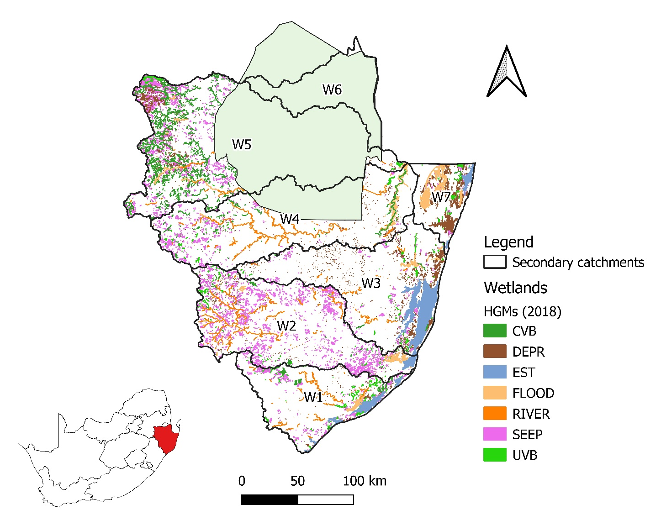
WETLAND TYPES (HGM):
% Extent (area) excl. EST
CVB | 15.3
DEPR | 15.1
FLOOD | 20.2
RIVER | 28.0
SEEP | 16.7
UVB | 4.8

Slide 6
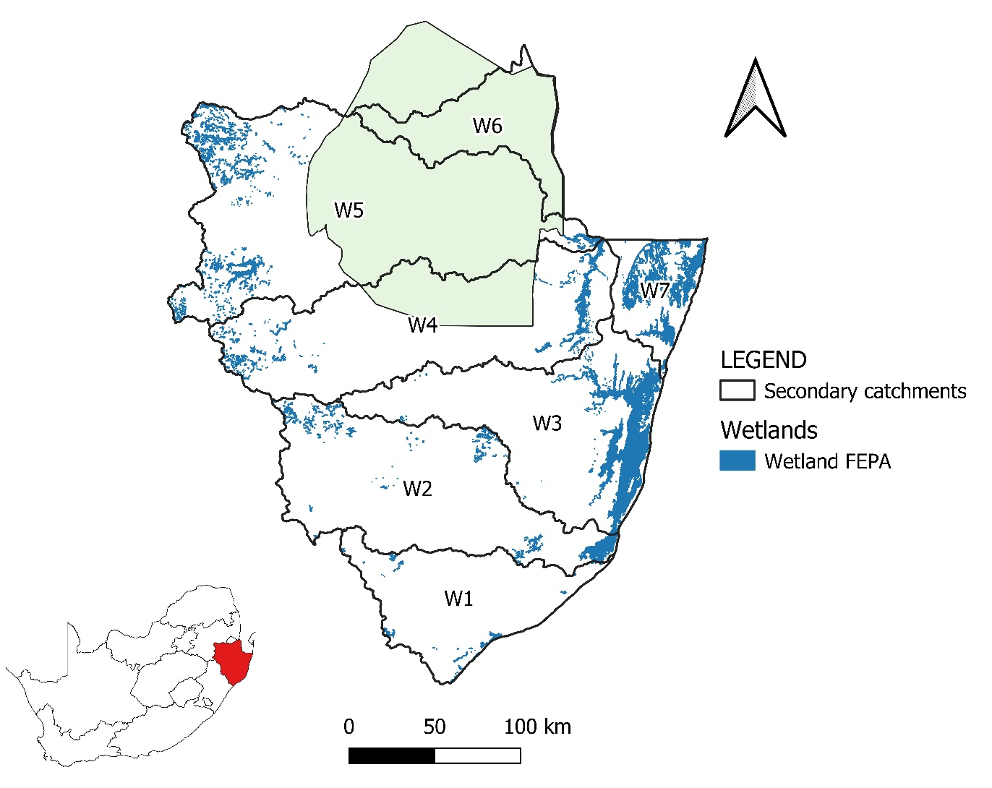
WETLAND FEPAS (NFEPA, 2011):

Slide 7
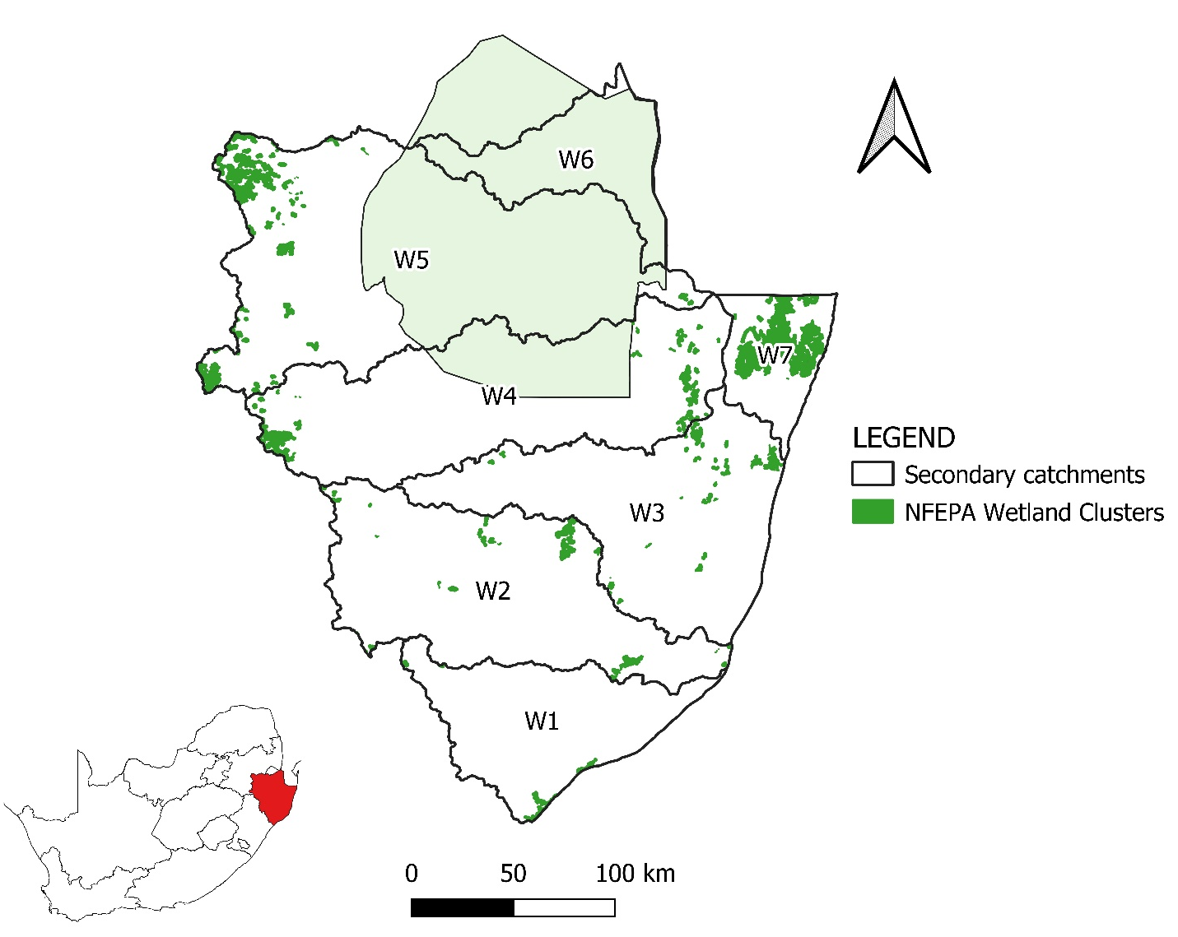
WETLAND CLUSTERS (NFEPA, 2011):

Slide 8
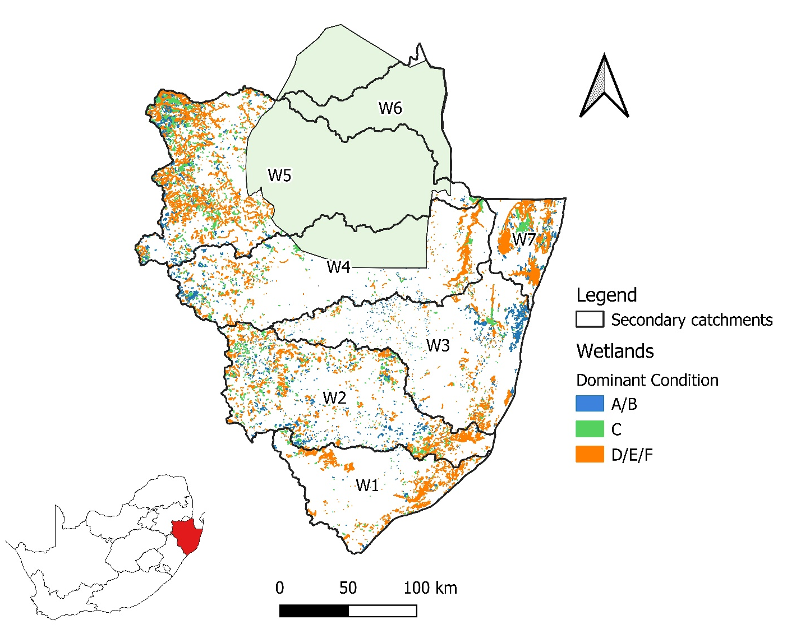
WETLAND PES (NBA, 2018):
% Extent (area) excl. EST
A/B | 13.0
C | 16.7
D/E/F | 70.3

Slide 9
WETLAND APPROACH: PRIORITY
  Determine wetland PES at SQ scale
  Determine wetland ecological importance
  Determine wetland ecological sensitivity
  Determine wetland importance score (integrate the above)
  Determine integrated environmental importance by integrate of the importance score and PES.
  Determine wetland priority by integration of IEI and WRUI
  Identify high priority and important wetlands

Slide 10
WETLAND APPROACH: IMPORTANCE
  NBA (2018) – Diversity and extent of wetlands
  NFEPA (2011) – Ramsar, FEPA, Cluster, habitats for threatened species
  Peatlands
  Important Birding Areas (2015)
  PES/EI/ES (DWS, 2014) – EI score (0 - 5) normalised to 4
  Regions / Centres of Plant Endemism (Van Wyk & Smith, 2001)
  Region Conservation Plans including KZN, MPU

Slide 11
WETLAND APPROACH: SENSITIVITY
  NBA (2018) – Protection level, threat status
  Threatened Ecosystems (SANBI, 2011)
  Threatened Plant Species (SANBI, 2009)
  PES/EI/ES (DWS, 2014) – ES score (0 - 5) normalised to 4

Slide 12
WETLAND APPROACH: PRIORITY

Slide 13
W1 (Mhlathuze): WETLANDS
IUA W12-a_(Upper Mhlathuze).
Most in C PES.
High Priority: Nyawushane, Mhlathuze
IUA W12-b_(Mfule, Mhlatuzane, Nseleni).
Nseleni, Nsezi,
IUA W12-c (Lower Mhlathuze).
Most in a D-F PES.
High Priority: Mhlathuze (incl swamp system), Mtambanana
IUA W12-d (Nhlabane)
Most D-F PES. Nhlabane, Mzingwenya, Lake Cubhu
IUA W12-e (Msingazi)
High Priority: Mzingazi
IUA W11 (Matigulu).
Most in D-F PES
IUA W13 (Mlalazi)
Most D-F PES.
High Priority: Mlalazi
Notes:
Caryn to do the scope, will be Tasks of study, deliverables, reference to previous ewr study, use some of following slides, but simplify

Slide 14
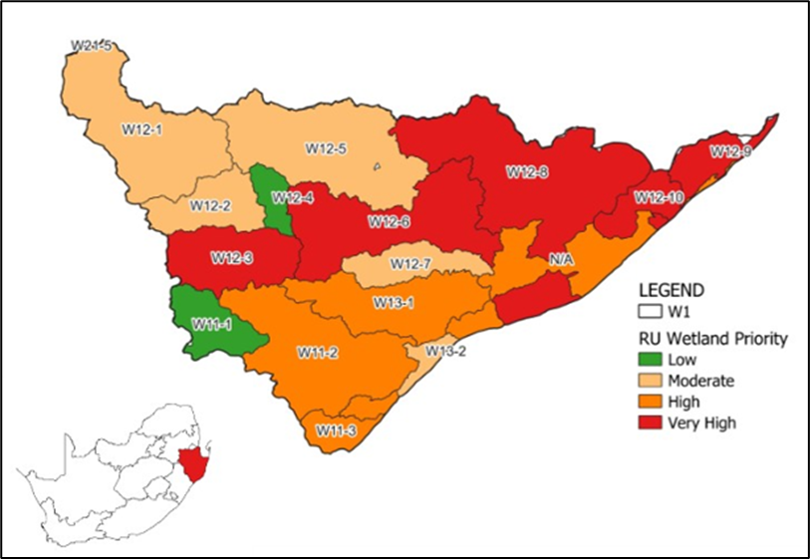

Slide 15
W2 (Umfolozi): WETLANDS
IUA W23 (Upper Umfolozi incl Lower White & Black Umfolozi)
Most D-F PES.
High Priority: RU W23-3
IUA W21 (Upper & Middle White Umfolozi).
Very High Priority: White Umfolozi
IUA W22_(Upper Black Umfolozi)
Most D-F PES.
Notes:
Caryn to do the scope, will be Tasks of study, deliverables, reference to previous ewr study, use some of following slides, but simplify

Slide 17
W3 (Mkuze): WETLANDS
IUA W31-a (Upper Mkuze)
Most D-F PES.
High Priority: Mkuze
IUA W31-b (Lower Mkuze)
Most A-B PES.
High Priority: Mkuze (Nhlnhlela Pan, Nsumu
IUA W32-a (Upper Hluhluwe).
Most D-F PES.
IUA W32-b (Nyalezi & Mzinene)
Notes:
Caryn to do the scope, will be Tasks of study, deliverables, reference to previous ewr study, use some of following slides, but simplify

Slide 18
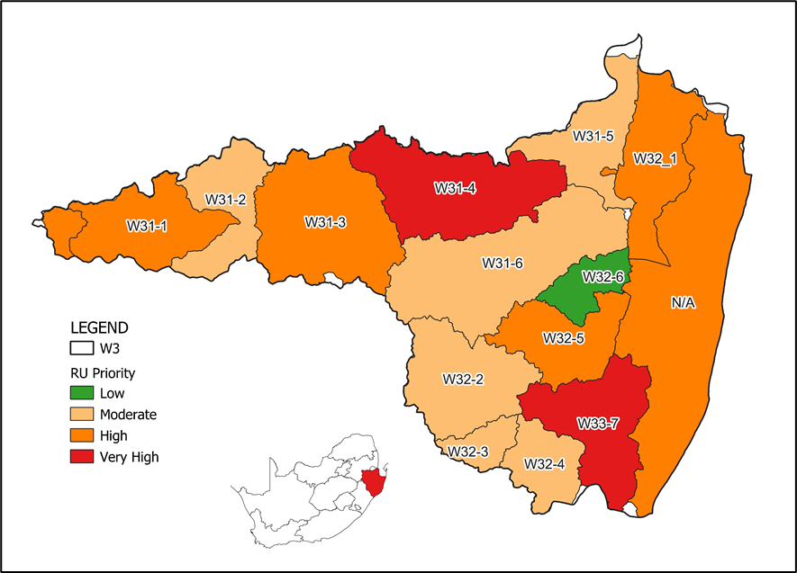

Slide 19
W4 (Pongola): WETLANDS
IUA W42-a (Upper Pongola)
Most A-B & D-F PES.
IUA W42-b (Middle Pongola, Ithala).
Most C PES.
IUA W45 (Lower Pongola Floodplain)
Most D-F PES.
Very High Priority Ngwavuma, Ndumo
High: Pongola
IUA W44 (Middle Pongola)
IUA W41 (Bivane)
Most D-F PES.
Very High Priority: Bivane
Notes:
Caryn to do the scope, will be Tasks of study, deliverables, reference to previous ewr study, use some of following slides, but simplify

Slide 20
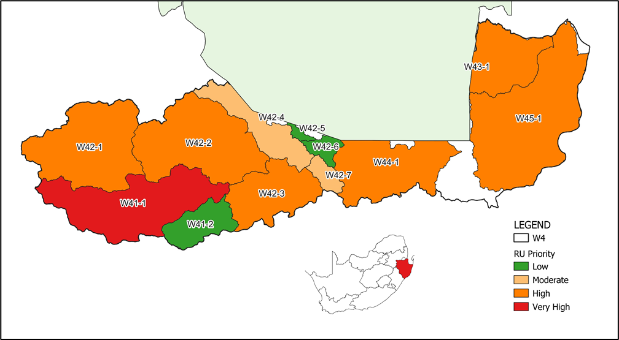

Slide 21
W5 (Usutu): Status quo
IUA W55 (Mpuluzi & Lusushwana).
Most D-F PES.
Very High Priority: Pan district around Chrissiesmeer, Majosie se Vlei, Mpuluzi
IUA W52 (W5 Downstream major dams and Hlelo)
Most D-F PES.
Very High Priority: Boesmanspruit, Assegaai, Swartwater, Mhknodvo,
IUA W57 (Lower Usutu)
Most C PES.
Very High Priority: uSuthu, Banzi Pan, Ndumo, Shokwe Pan
IUA W51 (W5 Upstream Major Dams)
Most D-F PES.
Very High Priority: Sandspruit, Ngwempisi, uSuthu (Coalbank, Liefgekozen, Seganagana)

Slide 23
W7 (Kosi & Sibaya): Status quo
IUA W70-a (Kosi)
Most D-F PES.
Very High Priority: Swamanzi
IUA W70-b (Sibaya)
Most D-F PES.
Very High Priority
Lake Sibaya, Muzi swamps
Notes:
Caryn to do the scope, will be Tasks of study, deliverables, reference to previous ewr study, use some of following slides, but simplify

Slide 24
